Slide 1
MACHINE LEARNING PROJECT
Credit Card Fraud
Detection System
A hybrid approach combining Logistic Regression and Isolation Forest to identify suspicious transactions and strengthen financial security.
Problem Definition
Dataset & EDA
Preprocessing
Modeling

Slide 2
PROBLEM DEFINITION
What We're Solving, and Why It Matters
1
3
What problem are we solving?
Who will use the solution?
Identifying fraudulent credit card transactions in real time, separating them from the overwhelming majority of legitimate purchases.
Banks, payment processors, and fraud-risk teams who need to flag suspicious transactions before funds are lost.
2
4
Why is this problem important?
What is the expected output?
Fraud causes direct monetary losses for banks and cardholders, and undetected fraud erodes trust in digital payment systems.
For each transaction, a classification — legitimate or fraudulent — plus an anomaly score highlighting unusual behavior.

Slide 3
ABSTRACT
Project Overview
Core Techniques
Credit card fraud is a major financial security problem that can cause significant monetary losses for both customers and financial institutions. This project presents a machine learning-based Credit Card Fraud Detection System using Logistic Regression and Isolation Forest anomaly detection techniques. Logistic Regression is used as a supervised classification model to identify transactions as legitimate or fraudulent based on patterns learned from historical transaction data. Isolation Forest is applied as an unsupervised anomaly detection method to identify unusual transactions that significantly differ from normal transaction behavior. The dataset is preprocessed by handling missing values, scaling numerical features, and addressing the highly imbalanced nature of fraud detection data. The performance of the models is evaluated using metrics such as accuracy, precision, recall, F1-score, confusion matrix, and ROC-AUC. By combining supervised classification with anomaly detection, the proposed system aims to improve the identification of suspicious transactions and provide a more reliable approach to detecting credit card fraud. This project demonstrates how machine learning can be effectively applied to enhance financial transaction security and reduce fraudulent losses.
Logistic Regression
Supervised classification of legitimate vs. fraudulent transactions
Isolation Forest
Unsupervised detection of anomalous transaction behavior
Evaluation Metrics
Accuracy
Precision
Recall
F1-Score
Confusion Matrix
ROC-AUC

Slide 4
DATASET COLLECTION
Sourcing and Understanding the Dataset
Source
Kaggle — “Credit Card Fraud Detection” dataset, released by the Machine Learning Group at ULB (Université Libre de Bruxelles). Downloaded as a single CSV file for offline analysis.
Dataset Schema
Time
Seconds since first transaction
Target / Output Column
V1 – V28
Anonymized PCA components
Class — a binary label: 0 for a legitimate transaction, 1 for a fraudulent one. This is the column the models are trained to predict.
Amount
Transaction value ($)
Feature Columns
Class
Target: 0 = legitimate, 1 = fraud
Time and Amount describe the raw transaction, while V1–V28 are anonymized, PCA-transformed features protecting cardholder privacy.
284,807
31
Rows
Columns

Slide 5
DATA UNDERSTANDING
Getting to Know the Dataset
284,807
31
Numeric
Records
Features (incl. target)
Data Types (all float / int)
0
1,081
2
Missing Values
Duplicate Rows
Unique Classes
Statistical Summary & Distributions
df.describe() shows Amount ranging from $0 to $25,691 (right-skewed, mean ≈ $88); Time spans ~48 hours; most V1–V28 features are centered near 0 with unit-scale variance — explored visually in the EDA section.

Slide 6
DATA PREPROCESSING
Cleaning and Preparing the Data
1
Missing Values
2
Duplicate Records
Checked with df.isnull().sum() — none found, so no imputation was required.
1,081 duplicate rows identified and removed with drop_duplicates() to prevent data leakage.
3
Outliers
4
Incorrect Data
Extreme Amount values reviewed via boxplots; retained since large transactions can be genuine fraud signals.
Verified Time and Amount are non-negative and Class contains only {0, 1}, with no invalid entries.
5
Categorical Variables
6
Numerical Variables
None present — all features are numeric, so no encoding step was needed.
Time and Amount were standardized with StandardScaler so their scale matches the already-scaled V1–V28 features.

Slide 7
EXPLORATORY DATA ANALYSIS
Class Imbalance at a Glance
Class Distribution
1
Severe Class Imbalance
Roughly 492 fraud cases out of 284,807 transactions — models need resampling or weighting to avoid bias.
2
PCA-Transformed Features
Features V1–V28 are anonymized principal components, already decorrelated and roughly scaled.
3
Raw-Scale Outliers
'Time' and 'Amount' remain in their original scale and need standardization before modeling.
4
No Significant Missing Data
Fraud cases make up only ~0.17% of all transactions — a textbook class-imbalance problem.
The dataset is largely complete, so preprocessing focuses on scaling and balancing rather than imputation.
284,807
Total Transactions
492
Fraud Cases
30
Features
0.17%
Fraud Rate

Slide 8
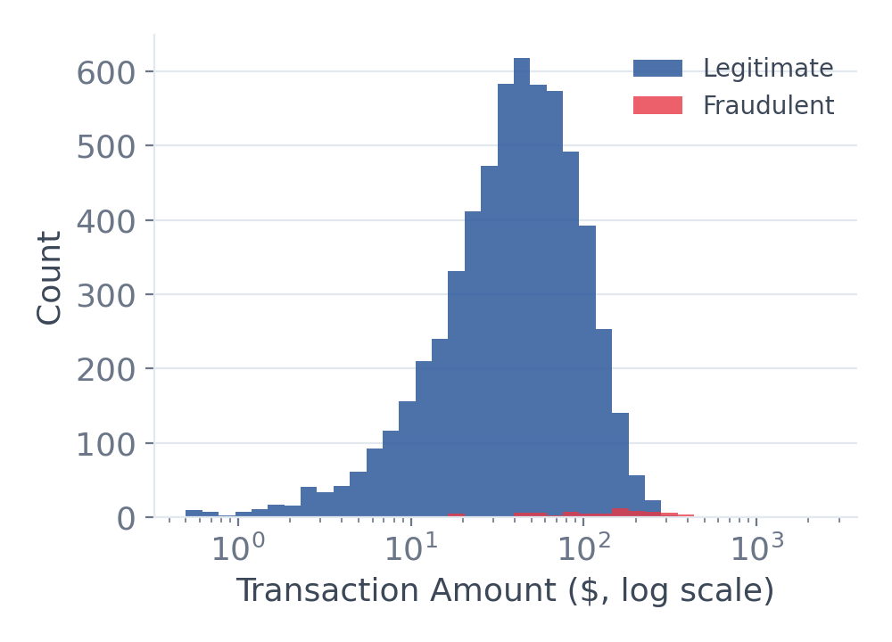
EXPLORATORY DATA ANALYSIS
Visualizing the Transaction Data
Histogram — Amount Distribution
Bar Chart — Avg. Amount by Hour Block
Count Plot — Class Counts
Legitimate amounts cluster low; fraud skews toward a wider, higher range.
Average spend is higher during midday and evening transaction blocks.
Plotted on a linear scale, fraud cases are barely visible next to legitimate volume — reinforcing the imbalance.

Slide 9
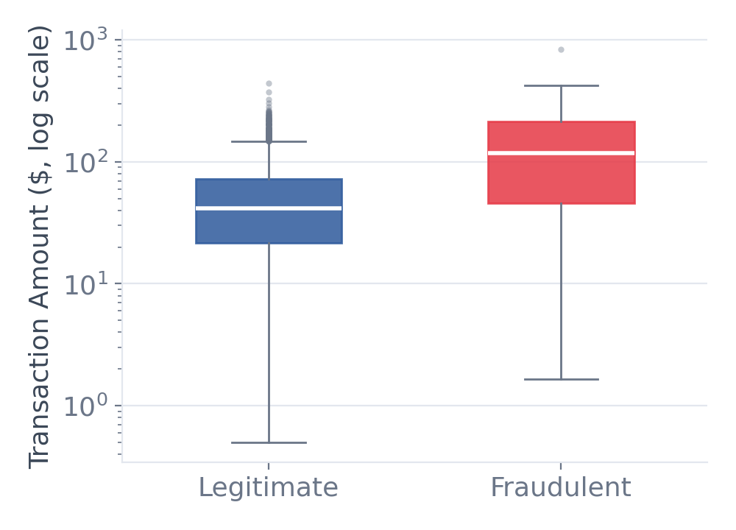
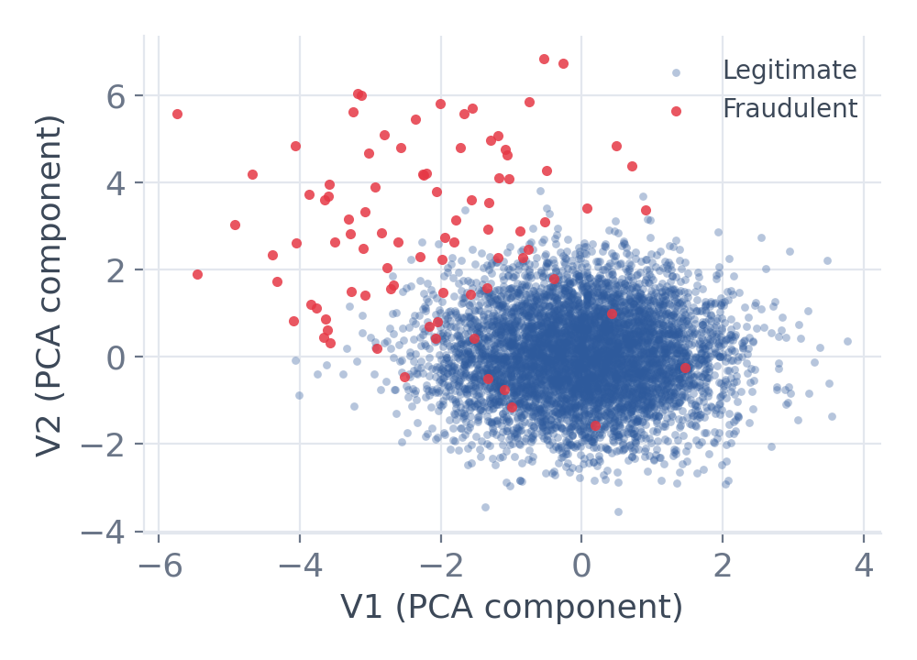
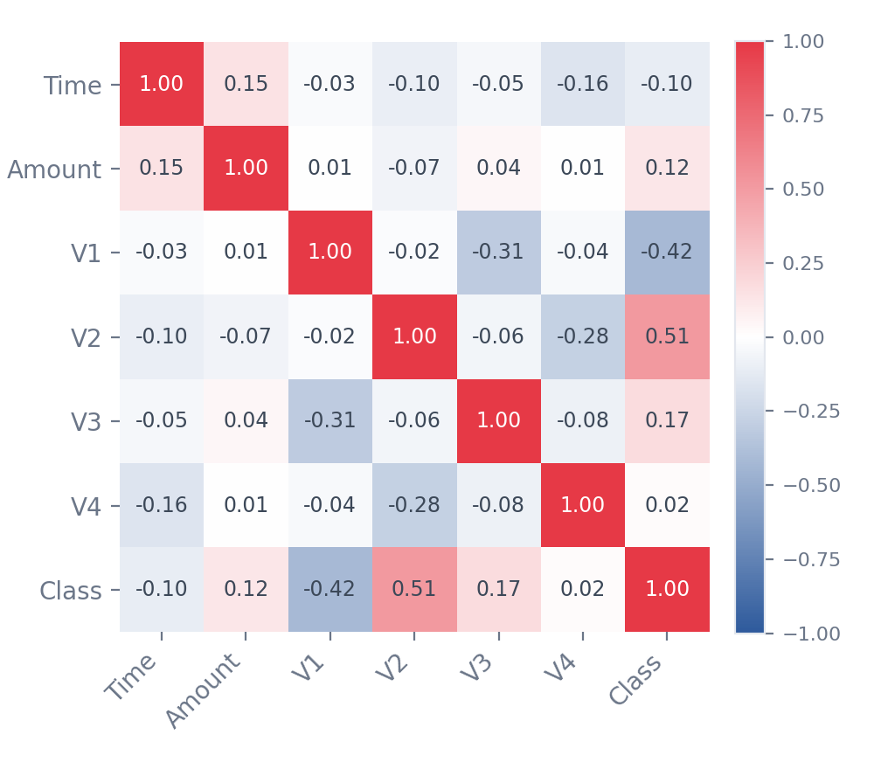
EXPLORATORY DATA ANALYSIS
Spotting Patterns and Relationships
Box Plot — Amount by Class
Scatter Plot — V1 vs V2 by Class
Correlation Heatmap
Fraudulent transactions show a higher median amount and wider spread.
Fraudulent points cluster apart from legitimate ones in PCA feature space.
V2 and V1 show the strongest linear relationship with Class among sampled features.

